Slide 1

Unit-4 Partial Derivatives
Mathematics-I (M-I)
GTU # 3110014
Prof. Darshan R. Pipaliya
Humanities & Science Department
darshan.pipaliya@darshan.ac.in
8160597689

Slide 2

Method:7
Local Extreme Values

Slide 3
Local Extreme Values of Function of Two Variables
A point $\left(a, b\right)$is said to be a stationary point of $f\left(x, y\right)$if
$${\left(\frac{∂f}{ ∂x }\right)}_{\left(a, b\right)}=0 \& {\left(\frac{∂f}{ ∂y }\right)}_{\left(a, b\right)}=0\text{.}$$
A stationary point$\left(a, b\right)$is said to be a saddle point of $f\left(x, y\right)$if at point$\left(a, b\right)$
given function has neither local minima nor local maxima.
A local minimum OR local maximum of a function is called local extreme values.

Slide 4
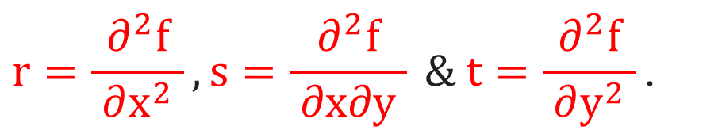
Procedure to Find Local Extreme Values of Function f(x, y)
$$\frac{∂f}{ ∂x } \& \frac{∂f}{ ∂y }\text{.}$$
$$\left(1\right).$$
Find
$$\frac{∂f}{ ∂x }=0, \frac{∂f}{ ∂y }=0$$
$$\left(2\right).$$
Solve
to find the stationary points $\left(a_{1},b_{1}\right), \left(a_{2},b_{2}\right),…\text{.}$
$$r=\frac{∂^{2}f}{ ∂x^{2} }, s=\frac{∂^{2}f}{ ∂x∂y } \& t=\frac{∂^{2}f}{ ∂y^{2} }\text{.}$$
$$\left(3\right).$$
Find
$$r={\left(\frac{∂^{2}f}{ ∂x^{2} }\right)}_{\left(a_{1},b_{1}\right)}, s={\left(\frac{∂^{2}f}{ ∂x∂y }\right)}_{\left(a_{1},{ b}_{1}\right)} \& t={\left(\frac{∂^{2}f}{ ∂y^{2} }\right)}_{\left(a_{1},b_{1}\right)}\text{.}$$
$$\left(4\right).$$
Find

Slide 5
Procedure to Find Local Extreme Values of Function f(x, y)
$$\left(5\right).$$
Find$rt−s^{2}$for stationary point $\left(a_{1},b_{1}\right)\text{.}$
$$\left(6\right).$$
Conclusion for stationary point $(a_{1},b_{1})$from the following table.
RESULT
CONCLUSION
$$rt−s^{2}>0 \& r>0$$
Function has local minimum value
$$rt−s^{2}>0 \& r<0$$
Function has local maximum value
$$rt−s^{2}<0$$
Function has no local maxima or local
minima (i.e. saddle point)
$$rt−s^{2}=0 OR r=0$$
Nothing can be said about the local
maxima or local minima.
It requires further investigation.

Slide 6
Procedure to Find Local Extreme Values of Function f(x, y)
$$\left(7\right).$$
Repeat step (4), (5) & (6) for all stationary points.
$$\left(8\right).$$
Substitute the point $(a_{i}, b_{i})$in the given function to find the local maximum
or local minimum value of the function at that point, if possible.

Slide 7
Example of Local Extreme Values
Example 2:
Find extreme values of $f\left(x, y\right)=x^{3}+3xy^{2}−15x^{2}−15y^{2}+72x\text{.}$
Solution:
Here, $x^{3}+3xy^{2}−15x^{2}−15y^{2}+72x\text{.}$
$$\frac{∂f}{ ∂x }=$$
$$\frac{∂f}{ ∂y }=$$
$$6xy−30y$$
$$3x^{2}+3y^{2}−30x+72$$
$$6xy−30y$$
$$3x^{2}+3y^{2}−30x+72$$
$$6xy−30y$$
$$r=\frac{∂^{2}f}{ ∂x^{2} }$$
$$=\frac{∂}{ ∂x }\left(\frac{∂f}{ ∂x }\right)$$
$$=\frac{∂}{ ∂x }\left( \right)$$
$$=6x−30$$
$$s=\frac{∂^{2}f}{ ∂x∂y }$$
$$=\frac{∂}{ ∂x }\left(\frac{∂f}{ ∂y }\right)$$
$$=\frac{∂}{ ∂x }\left( \right)$$
$$=6y$$
$$t=\frac{∂^{2}f}{ ∂y^{2} }$$
$$=\frac{∂}{ ∂y }\left(\frac{∂f}{ ∂y }\right)$$
$$=\frac{∂}{ ∂y }\left( \right)$$
$$=6x−30$$

Slide 8
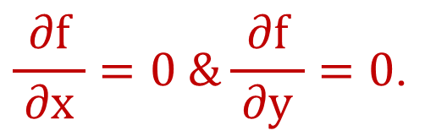

Example of Local Extreme Values
$$\frac{∂f}{ ∂x }=0 \&\frac{∂f}{ ∂y }=0\text{.}$$
Solution Continue:
$$For stationary point$$
$$3x^{2}+3y^{2}−30x+72=0$$
$$y=0$$
$$Case:1$$
$$0$$
$$⇒3\left(x^{2}+y^{2}−10x+24\right)=0$$
$$⇒x^{2}+y^{2}−10x+24=0$$
$$⇒x^{2}+y^{2}−10x+24=0$$
$$⇒x^{2}+{\left(\right)}^{2}−10x+24=0$$
$$⇒x^{2}−10x+24=0$$
$$6xy−30y=0$$
$$⇒x^{2}−4x−6x+24=0$$
$$⇒6y\left(x−5\right)=0$$
$$⇒x\left(x−4\right)−6\left(x−4\right)=0$$
$$⇒y\left(x−5\right)=0$$
$$⇒x−4=0$$
$$OR$$
$$x−6=0$$
$$⇒y=0$$
$$OR$$
$$x−5=0$$
$$⇒x=4$$
$$OR$$
$$x=6$$
$$⇒y=0$$
$$OR$$
$$x=5$$

Slide 9
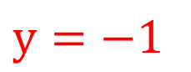
Example of Local Extreme Values
Solution Continue:
$$5$$
$$x=5$$
$$Case:2$$
$$5$$
$$0$$
$$y=0$$
$$Case:1$$
$$0$$
$$4$$
$$OR$$
$$6$$
$$⇒x^{2}+y^{2}−10x+24=0$$
$$⇒x=4$$
$$x=6$$
$$⇒{\left(\right)}^{2}+y^{2}−10\left(\right)+24=0$$
Hence, stationary points are
$$⇒25+y^{2}−50+24=0$$
$$\left( , \right) \& \left( , \right)\text{.}$$
$$⇒y^{2}−1=0$$
$$5$$
$$5$$
$$Case:2$$
$$x=5$$
$$⇒y^{2}=1$$
$$⇒y=1$$
$$y=−1$$
$$1$$
$$OR$$
$$−1$$
$$⇒y=1$$
$$OR$$
$$y=−1$$
Hence, stationary points are
$$\left( , \right) \& \left( , \right)\text{.}$$

Slide 10
Example of Local Extreme Values
Solution Continue:
Stationary Points
$$Conclusion$$
$$r=6x−30$$
$$s=6y$$
$$t=6x−30$$
$$rt−s^{2}$$
$$\left(4, 0\right)$$
$$−6$$
$$0$$
$$−6$$
$$36>0\left(r<0\right)$$
Local Maxima
$$\left(6, 0\right)$$
$$6$$
$$0$$
$$6$$
$$36>0\left(r>0\right)$$
Local Minima
$$\left(5, 1\right)$$
$$0$$
$$6$$
$$0$$
$$−36<0$$
Saddle Point
$$\left(5, −1\right)$$
$$0$$
$$−6$$
$$0$$
$$−36<0$$
Saddle Point

Slide 11
Example of Local Extreme Values
Example 2:
Find extreme values of $f\left(x, y\right)=x^{3}+3xy^{2}−15x^{2}−15y^{2}+72x\text{.}$
Solution Continue:
$Max\left( f \right)$
$$=f{\left(x,y\right)}_{\left(4, 0\right)}$$
$$={\left(\right)}^{3}+3\left(\right){\left(\right)}^{2}−15{\left(\right)}^{2}−15{\left(\right)}^{2}+72\left(\right)$$
$$4$$
$$4$$
$$0$$
$$4$$
$$0$$
$$4$$
$$=4^{2}\left(4−15+18\right)$$
$$=16\left(7\right)$$
$$=112$$
$$⇒Max\left( f \right)=112$$
$Min\left( f \right)$
$$=f{\left(x,y\right)}_{\left(6, 0\right)}$$
$$6$$
$$6$$
$$0$$
$$6$$
$$0$$
$$6$$
$$={\left(\right)}^{3}+3\left(\right){\left(\right)}^{2}−15{\left(\right)}^{2}−15{\left(\right)}^{2}+72\left(\right)$$
$$=6^{2}\left(6−15+12\right)$$
$$=36\left(3\right)$$
$$=108$$
$$⇒Min\left( f \right)=108$$

Slide 12
Example of Local Extreme Values
Example 1:
Find the local extreme values of $f\left(x, y\right)=x^{2}−y^{2}−xy−x+y+6 ,$
if possible$\text{.}$
Solution:
Here, $f\left(x, y\right)=x^{2}−y^{2}−xy−x+y+6$.
$$r=\frac{∂^{2}f}{ ∂x^{2} }$$
$$=\frac{∂}{ ∂x }\left(\frac{∂f}{ ∂x }\right)$$
$$=\frac{∂}{ ∂x }\left( \right)$$
$$=2$$
$$\frac{∂f}{ ∂x }=$$
$$2x−y−1$$
$$2x−y−1$$
$$s=\frac{∂^{2}f}{ ∂x∂y }$$
$$=\frac{∂}{ ∂x }\left(\frac{∂f}{ ∂y }\right)$$
$$=\frac{∂}{ ∂x }\left( \right)$$
$$=−1$$
$$\frac{∂f}{ ∂y }=$$
$$−2y−x+1$$
$$−2y−x+1$$
$$−2y−x+1$$
$$t=\frac{∂^{2}f}{ ∂y^{2} }$$
$$=\frac{∂}{ ∂y }\left(\frac{∂f}{ ∂y }\right)$$
$$=\frac{∂}{ ∂y }\left( \right)$$
$$=−2$$

Slide 13
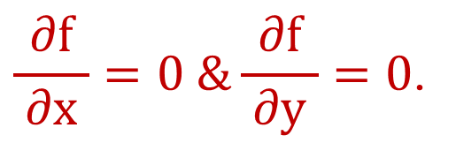
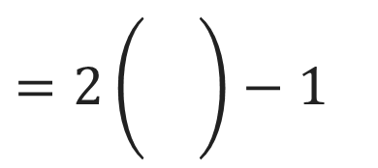

Example of Local Extreme Values
$$\frac{∂f}{ ∂x }=0 \&\frac{∂f}{ ∂y }=0\text{.}$$
Solution Continue:
$$For stationary point$$
$$⇒2x−y−1=0$$
$$\&$$
$$−2y−x+1=0$$
$$⇒$$
$$2x−y=1$$
$\left(1\right)$
$$2x−y=1$$
$$\&$$
$$x+2y=1$$
$\left(2\right)$
$$⇒y=2x−1$$
$$=2\left(\frac{}{}\right)−1$$
$$4x−2y=2$$
$$2×eq^{n}\left(1\right)$$
$$⇒$$
$$+$$
$$x+2y=1$$
$\left(2\right)$
$$=\left(\frac{6}{ 5 }\right)−1$$
$$5x$$
$$=3$$
$$\frac{3}{ 5 }$$
$$⇒x=\frac{3}{ 5 }$$
$$⇒y=\frac{1}{ 5 }$$

Slide 14
Example of Local Extreme Values
Solution Continue:
$$\left(\frac{3}{ 5 },\frac{1}{ 5 }\right)\text{.}$$
Hence, stationary point is
Here$, r=2, s=−1 \& t=−2\text{.}$
$$⇒r=2, s=−1 \& t=−2 at\left(\frac{3}{ 5 },\frac{1}{ 5 }\right)$$
$$⇒rt−s^{2}=\left(2\right)\left(−2\right)−{\left(−1\right)}^{2}$$
$$=−4−1$$
$$=−5$$
$$⇒rt−s^{2}<0$$
$$⇒ \left(\frac{3}{ 5 },\frac{1}{ 5 }\right) is saddle point\text{.}$$

Slide 15
Example of Local Extreme Values
Example 8:
For what values of the constant k does the second derivative test
guarantee that $f\left(x, y\right)=x^{2}+kxy+y^{2}$ will have a saddle point at
$\left(0, 0\right)?$A local minimum at $\left(0, 0\right)?$
Solution:
Here, $f\left(x, y\right)=x^{2}+kxy+y^{2}\text{.}$
$$r=\frac{∂^{2}f}{ ∂x^{2} }$$
$$=\frac{∂}{ ∂x }\left(\frac{∂f}{ ∂x }\right)$$
$$=\frac{∂}{ ∂x }\left( \right)$$
$$=2$$
$$\frac{∂f}{ ∂x }=$$
$$2x+ky$$
$$2x+ky$$
$$s=\frac{∂^{2}f}{ ∂x∂y }$$
$$=\frac{∂}{ ∂x }\left(\frac{∂f}{ ∂y }\right)$$
$$=\frac{∂}{ ∂x }\left( \right)$$
$$=k$$
$$\frac{∂f}{ ∂y }=$$
$$kx+2y$$
$$kx+2y$$
$$kx+2y$$
$$t=\frac{∂^{2}f}{ ∂y^{2} }$$
$$=\frac{∂}{ ∂y }\left(\frac{∂f}{ ∂y }\right)$$
$$=\frac{∂}{ ∂y }\left( \right)$$
$$=2$$

Slide 16
Example of Local Extreme Values
$$\frac{∂f}{ ∂x }=0 \&\frac{∂f}{ ∂y }=0\text{.}$$
Solution Continue:
$$For stationary point$$
$$⇒$$
$$2x+ky=0$$
$$2x+ky=0$$
$$\&$$
$$kx+2y=0$$
$$⇒2\left(\right)+ky=0$$
$$⇒ky=0$$
$$4x +2ky=0$$
$$⇒$$
$$⇒y=0$$
$${−k}^{2}x−2ky=0$$
Hence, stationary point is $\left(0, 0\right)\text{.}$
$$\left(4−k^{2}\right)x=0$$
$$⇒x=0$$
$$0$$

Slide 17
Example of Local Extreme Values
Solution Continue:
For saddle point at$\left(0, 0\right),$
For local minimum at $\left(0, 0\right),$
$${\left(rt−s^{2}\right)}_{\left(0, 0\right)}<0\text{.}$$
$${\left(rt−s^{2}\right)}_{\left(0, 0\right)}>0,\left(r>0/t>0\right)\text{.}$$
$$⇒\left(2\right)\left(2\right)−k^{2}<0$$
$$⇒\left(2\right)\left(2\right)−k^{2}>0$$
$$⇒4−k^{2}<0$$
$$⇒k^{2}>4$$
$$⇒4−k^{2}>0$$
$$⇒k^{2}<4$$
$$⇒k∈ℝ−\left[−2, 2\right]$$
$$⇒k∈\left(−2, 2\right)$$

Slide 18
Method:8
Lagrange’s Multiplier

Slide 19
Lagrange’s Multiplier Method
This method is apply for finding maxima & minima of given function with
satisfying given condition(constraint).
The drawback of this method is that it gives no information about the nature $of$
stationary point directly i.e. about maxima and minima.
Here unknown constant λ is known as Lagrange’s multiplier.
The distance between two points $P\left(x, y,z\right) \& Q\left(a, b, c\right)$ is
$PQ=\sqrt{{\left(x−a\right)}^{2}+{\left(y−b\right)}^{2}+{\left(z−c\right)}^{2}}$.

Slide 20
Lagrange’s Multiplier Method
Procedure for find finding maxima & minima of the function $f\left(x, y\right)$with
satisfying the condition $ϕ\left(x, y\right)=0$is as follow$:$
$$\left(1\right).$$
Construct the new function$F\left(x, y\right) as F\left(x, y\right)=f\left(x, y\right)+λ$ $ϕ\left(x, y\right)$.
$$\frac{∂F}{ ∂x }=0, \frac{∂F}{ ∂y }=0 \& ϕ\left(x, y\right)=0$$
$$\left(2\right).$$
Solve the three equations
to find the
stationary points $\left(x_{1}, y_{1}\right), \left(x_{2}, y_{2}\right), …\text{.}$
$$\left(3\right).$$
Find the value of $f\left(x, y\right)$at above stationary points and give the conclusion about
maxima or minima.

Slide 21
Example of Lagrange’s Multiplier Method
Example 2:
Find the maximum and minimum values of function $f\left(x, y\right)=3x+4y$
on the circle $x^{2}+y^{2}=1$ using the method of Lagrange multiplier.
Here, $f\left(x, y\right)=3x+4y$
$$x^{2}+y^{2}−1$$
Solution:
$3x+4y$
and $ϕ\left(x, y\right)=x^{2}+y^{2}−1=0$.
Construct the new function$F\left(x, y\right) as F\left(x, y\right)=f\left(x, y\right)+λ$ $ϕ\left(x, y\right)$.
$$⇒F\left(x, y\right)=\left( \right)+λ\left( \right)$$
$$\frac{∂F}{ ∂x }=0, \frac{∂F}{ ∂y }=0 \& ϕ\left(x, y\right)=0$$
Solve three equations
for stationary points.
$$\frac{∂F}{ ∂x }=$$
$$\frac{∂F}{ ∂y }=$$
$$3+λ\left(2x\right)=0$$
$$4+λ\left(2y\right)=0$$
$$x^{2}+y^{2}−1=0$$
$$⇒λ=−\frac{3}{ 2x }$$
$$⇒λ=−\frac{4}{ 2y }$$
$${⇒x}^{2}+{ y}^{2}=1$$
$$− − →\left(3\right)$$
$$− − →\left(1\right)$$
$$− − →\left(2\right)$$

Slide 22
Example of Lagrange’s Multiplier Method
$$λ=−\frac{3}{ 2x }$$
Solution Continue:
$$− − →\left(1\right)$$
From equations $\left(1\right) \& \left(2\right)$
$$λ=−\frac{4}{ 2y }$$
$$−\frac{3}{ 2x }$$
$$=−\frac{4}{ 2y }$$
$$⇒y=\frac{ 4x }{3}$$
$$− − →\left(2\right)$$
S$ubstitute in \left(3\right)$
$$x^{2}+{ y}^{2}=1$$
$$− − →\left(3\right)$$
$$⇒x^{2}+{\left(\frac{ 4x }{3}\right)}^{2}=1$$
$$y=\frac{ 4x }{3}$$
$$⇒{25x}^{2}=9$$
$$=\frac{ 4 }{3}\left(±\frac{3}{ 5 }\right)$$
$$⇒x^{2}+\frac{16x^{2}}{9}=1$$
$$⇒x^{2}=\frac{9}{ 25 }$$
$$⇒{9x}^{2}+{16x}^{2}=9$$
$$⇒x=±\frac{3}{ 5 }$$
$$⇒y=±\frac{4}{ 5 }$$

Slide 23
Example of Lagrange’s Multiplier Method
Example 2:
Find the maximum and minimum values of function $f\left(x, y\right)=3x+4y$
on the circle $x^{2}+y^{2}=1$ using the method of Lagrange multiplier$\text{.}$
Solution Continue:
$$\left(\frac{3}{ 5 },\frac{4}{ 5 }\right) \&\left(−\frac{3}{ 5 },−\frac{4}{ 5 }\right)\text{.}$$
Hence, stationary points are
$$f\left(\frac{3}{ 5 },\frac{4}{ 5 }\right)=$$
$$3\left(\frac{3}{ 5 }\right)+4\left(\frac{4}{ 5 }\right)$$
$$f\left(−\frac{3}{ 5 },−\frac{4}{ 5 }\right)=−5\text{.}$$
Similarly, we get
$$=\frac{ 9+16 }{5}$$
$$=\frac{ 25 }{5}$$
Which is minimum
value of $f\left(x, y\right)$.
$$⇒ f\left(\frac{3}{ 5 },\frac{4}{ 5 }\right)=5.$$
Which is maximum
value of $f\left(x, y\right)\text{.}$

Slide 24
Lagrange’s Multiplier Method
Procedure for find finding maxima & minima of the function$f\left(x, y, z\right)$with
satisfying the condition $ϕ\left(x, y,z\right)=0$is as follow$:$
$$\left(1\right).$$
Construct the new function $F\left(x, y,z\right) as F\left(x, y,z\right)=f\left(x, y,z\right)+λ$ $ϕ\left(x, y, z\right)$.
$$\frac{∂F}{ ∂x }=0, \frac{∂F}{ ∂y }=0, \frac{∂F}{ ∂z }=0 \& ϕ\left(x, y, z\right)=0$$
$$\left(2\right).$$
Solve the four equations
to find
the stationary points $\left(x_{1}, y_{1},z_{1}\right), \left(x_{2}, y_{2},z_{2}\right), …\text{.}$
$$\left(3\right).$$
Find the value of $f\left(x, y, z\right)$at above stationary points and give the conclusion
about maxima or minima.

Slide 25
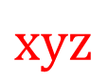
Example of Lagrange’s Multiplier Method
Example 5:
Divided a given number ‘a’ into three positive points such that their sum
is ‘a’ and product is maximum.
Solution:
$$x+y+z=a$$
$$\&$$
$x∙y∙z$ is maximum.
x
$$xyz$$
Hence, $f\left(x, y, z\right)=xyz$
$$x+y+z−a$$
$$\& ϕ\left(x, y, z\right)=x+y+z−a=0.$$
Construct the new function$F\left(x, y, z\right) as$
a
y
$F\left(x, y, z\right)=f\left(x, y, z\right)+λ$ $ϕ\left(x, y, z\right)\text{.}$
$$⇒F\left(x, y, z\right)=\left( \right)+λ\left( \right)$$
z
$$\frac{∂F}{ ∂x }=0, \frac{∂F}{ ∂y }=0, \frac{∂F}{ ∂z }=0 \& ϕ\left(x, y, z\right)=0$$
Solve the four equations to find
the stationary points.

Slide 26
Example of Lagrange’s Multiplier Method
Solution Continue:
$$F\left(x, y, z\right)=\left(xyz\right)+λ\left(x+y+z−a\right)$$
$$\frac{∂F}{ ∂x }=$$
$$\frac{∂F}{ ∂y }=$$
$$\frac{∂F}{ ∂z }=$$
$$yz+λ\left(1\right)=0$$
$$xz+λ\left(1\right)=0$$
$$xy+λ\left(1\right)=0$$
$$⇒λ=−yz$$
$$− − →\left(1\right)$$
$$⇒λ=−xz$$
$$− − →\left(2\right)$$
$$⇒λ=−xy$$
$$− − →\left(3\right)$$
From equations $\left(1\right), \left(2\right) \& \left(3\right)$ we get
$$x+y+z−a=0$$
$$−yz=−xz=−xy$$
$$⇒yz=xz=xy$$
$$\text{⇒} x+y+z=a$$
$$− − →\left(4\right)$$
$$yz=xz$$
$$xz=xy$$
$$⇒y=x$$
$$⇒z=y$$

Slide 27
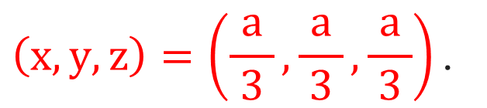
Example of Lagrange’s Multiplier Method
Solution Continue:
$$x+y+z=a$$
$$− − →\left(4\right)$$
$$y=x \&$$
$$z=y$$
$$⇒y+y+y=a$$
$$⇒3y=a$$
$$⇒y=\frac{a}{ 3 }$$
$$⇒x=\frac{a}{ 3 }$$
$$\& z=\frac{a}{ 3 }$$
$$⇒f\left(x, y, z\right)=\frac{a^{3}}{ 27 }$$
$$\left(x, y, z\right)=\left(\frac{a}{ 3 },\frac{a}{ 3 },\frac{a}{ 3 }\right)\text{.}$$
Hence, stationary point is
Which is maximum
value of $f\left(x, y, z\right)\text{.}$
$$=\frac{ a }{3}∙\frac{ a }{3}∙\frac{ a }{3}$$
$$=\frac{a^{3}}{ 27 }$$
$$⇒f\left(x, y, z\right)=xyz$$

Slide 28
Example of Lagrange’s Multiplier Method
Example 6:
Find the point on the plane $x+2y+3z=13$ closest to point $\left(1, 1, 1\right)\text{.}$
Solution:
Let, $P\left(x, y, z\right)$be the point on the plane $x+2y+3z=13$ closest to the
point $Q\left(1, 1, 1\right)\text{.}$
Hence distance between $P \& Q$ is minimum and which is defined as:
$$PQ=$$
$$\sqrt{{ \left(x−1\right)}^{2}+{\left(y−1\right)}^{2}+{\left(z−1\right)}^{2} }$$
$$⇒{PQ}^{2}=$$
$${\left(x−1\right)}^{2}+{\left(y−1\right)}^{2}+{\left(z−1\right)}^{2}$$
$$\& x+2y+3z=13$$
$${⇒f\left(x, y, z\right)=\left(x−1\right)}^{2}+{\left(y−1\right)}^{2}+{\left(z−1\right)}^{2}$$
$$\& ϕ\left(x, y, z\right)=x+2y+3z−13=0$$

Slide 29
Example of Lagrange’s Multiplier Method
$${f\left(x, y, z\right)=\left(x−1\right)}^{2}+{\left(y−1\right)}^{2}+{\left(z−1\right)}^{2}$$
Solution Continue:
$${\left(x−1\right)}^{2}+{\left(y−1\right)}^{2}+{\left(z−1\right)}^{2}$$
$$x+2y+3z−13$$
Construct the new function
$$ϕ\left(x, y, z\right)=x+2y+3z−13=0$$
$F\left(x, y, z\right)$as $F\left(x, y, z\right)=f\left(x, y, z\right)+λ$ $ϕ\left(x, y, z\right)\text{.}$
$$⇒F\left(x, y, z\right)=\left( \right)+λ\left( \right)$$
$$\frac{∂F}{ ∂x }=0, \frac{∂F}{ ∂y }=0, \frac{∂F}{ ∂z }=0 \& ϕ\left(x, y, z\right)=0$$
Solve the four equations
to find the
stationary points.
$$\frac{∂F}{ ∂x }=$$
$$\frac{∂F}{ ∂y }=$$
$$2\left(x−1\right)+λ\left(1\right)=0$$
$$2\left(y−1\right)+λ\left(2\right)=0$$
$$⇒λ=−2\left(x−1\right)$$
$$⇒λ=−\left(y−1\right)$$
$$− − →\left(2\right)$$
$$− − →\left(1\right)$$

Slide 30
Example of Lagrange’s Multiplier Method
Solution Continue:
$$F\left(x, y, z\right)=\left({\left(x−1\right)}^{2}+{\left(y−1\right)}^{2}+{\left(z−1\right)}^{2}\right)+λ\left(x+2y+3z−13 \right)$$
$$\frac{∂F}{ ∂z }=$$
$$2\left(z−1\right)+λ\left(3\right)=0$$
$$x+2y+3z−13=0$$
$$⇒λ=−\frac{2}{ 3 }\left(z−1\right)$$
$$\text{⇒} x+2y+3z=13$$
$$− − →\left(4\right)$$
$$− − →\left(3\right)$$
$$2\left(x−1\right)=y−1$$
From equations $\left(1\right), \left(2\right) \& \left(3\right)$ we get
$$−2\left(x−1\right)=−\left(y−1\right)=−\frac{2}{ 3 }\left(z−1\right)$$
$$\text{⇒}\text{ 2}x−2=y−1$$
$$\text{⇒}\text{ 2}x=y+1$$
$$⇒2\left(x−1\right)=\left(y−1\right)=\frac{2}{ 3 }\left(z−1\right)$$
$$⇒x=\frac{ y+1 }{2}$$
$$− − →\left(5\right)$$

Slide 31
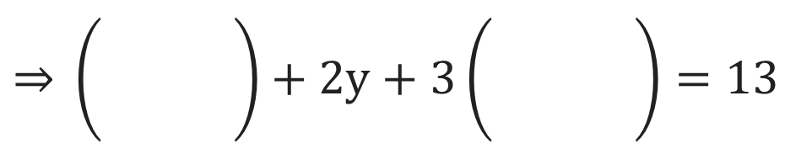
Example of Lagrange’s Multiplier Method
Solution Continue:
$$x+2y+3z=13$$
$$− − →\left(4\right)$$
$$x+2y+3z=13$$
$$2\left(x−1\right)=\left(y−1\right)=\frac{2}{ 3 }\left(z−1\right)$$
$$x=\frac{ y+1 }{2}$$
$$\frac{ y+1 }{2}$$
$$− − →\left(5\right)$$
$$\left(y−1\right)=\frac{2}{ 3 }\left(z−1\right)$$
$$\text{⇒} 3\left(y−1\right)=2\left(z−1\right)$$
$$\text{⇒} \left(\frac{\begin{aligned} \\ \end{aligned}}{ }\right)+2y+3\left(\frac{\begin{aligned} \\ \end{aligned}}{ }\right)=13$$
$$\text{⇒}\text{ 3}y−3=2z−2$$
$$\text{⇒} \left(\frac{ y+1 }{2}\right)+2y+\left(\frac{ 9y−3 }{2}\right)=13$$
$$\text{⇒}\text{ 3}y−1=2z$$
$$\frac{ 3y−1 }{2}$$
$$⇒z=\frac{ 3y−1 }{2}$$
$$− − →\left(6\right)$$
$$\text{⇒} y+1+4y+9y−3=26$$
$$\text{⇒} 14y=28$$

Slide 32
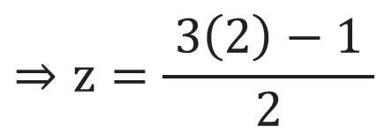
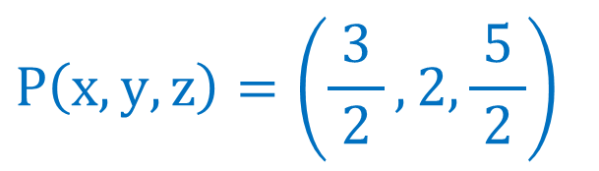
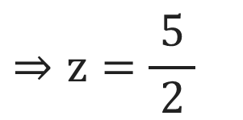
Example of Lagrange’s Multiplier Method
Solution Continue:
$$x=\frac{ y+1 }{2}$$
$$− − →\left(5\right)$$
$$x=\frac{ y+1 }{2}$$
$$z=\frac{ 3y−1 }{2}$$
$$14y=28$$
$$z=\frac{ 3y−1 }{2}$$
$$⇒y=\frac{ 28 }{14}$$
$$− − →\left(6\right)$$
$$⇒x=\frac{ 2+1 }{2}$$
$$⇒z=\frac{ 3\left(2\right)−1 }{2}$$
$$⇒y=2$$
$$⇒x=\frac{ 3 }{2}$$
$$⇒z=\frac{ 5 }{2}$$
$$P\left(x, y, z\right)=\left(\frac{ 3 }{2}, 2,\frac{ 5 }{2}\right)$$
Hence,
be the point on the plane $x+2y+3z=13$ closest
to the point $Q\left(1, 1, 1\right)\text{.}$

Slide 33
Example of Lagrange’s Multiplier Method
Example 8:
Find the shortest and largest distance from the point $\left(1, 2, −1\right)$ to the
sphere $x^{2}+y^{2}+z^{2}=24\text{.}$
Solution:
Let, $P\left(x, y, z\right)$be any point on surface of the sphere $x^{2}+y^{2}+z^{2}=24$
and $Q\left(1, 2, −1\right)$is the given point.
Hence, distance between $P \& Q$ is PQ which is defined as:
$$PQ=$$
$$\sqrt{{ \left(x−1\right)}^{2}+{\left(y−2\right)}^{2}+{\left(z+1\right)}^{2} }$$
$$⇒{PQ}^{2}=$$
$${\left(x−1\right)}^{2}+{\left(y−2\right)}^{2}+{\left(z+1\right)}^{2}$$
$$\& x^{2}+y^{2}+z^{2}=24$$
$${⇒f\left(x, y, z\right)=\left(x−1\right)}^{2}+{\left(y−2\right)}^{2}+{\left(z+1\right)}^{2}$$
$$\& ϕ\left(x, y, z\right)=x^{2}+y^{2}+z^{2}−24=0$$

Slide 34
Example of Lagrange’s Multiplier Method
$${f\left(x, y, z\right)=\left(x−1\right)}^{2}+{\left(y−2\right)}^{2}+{\left(z+1\right)}^{2}$$
Solution Continue:
$${\left(x−1\right)}^{2}+{\left(y−2\right)}^{2}+{\left(z+1\right)}^{2}$$
$$ϕ\left(x, y, z\right)=x^{2}+y^{2}+z^{2}−24=0$$
Construct the new function
$$x^{2}+y^{2}+z^{2}−24$$
$F\left(x, y, z\right)$as $F\left(x, y, z\right)=f\left(x, y, z\right)+λ$ $ϕ\left(x, y, z\right)\text{.}$
$$⇒F\left(x, y, z\right)=\left( \right)+λ\left( \right)$$
$$\frac{∂F}{ ∂x }=0, \frac{∂F}{ ∂y }=0, \frac{∂F}{ ∂z }=0 \& ϕ\left(x, y, z\right)=0$$
Solve the four equations
to find the
stationary points.
$$\frac{∂F}{ ∂x }=$$
$$\frac{∂F}{ ∂y }=$$
$$2\left(x−1\right)+λ\left(2x\right)=0$$
$$2\left(y−2\right)+λ\left(2y\right)=0$$
$$⇒λ=−\frac{\left(x−1\right)}{x}$$
$$⇒λ=−\frac{\left(y−2\right)}{y}$$
$$− − →\left(1\right)$$
$$− − →\left(2\right)$$

Slide 35
Example of Lagrange’s Multiplier Method
Solution Continue:
$$F\left(x, y, z\right)=\left({\left(x−1\right)}^{2}+{\left(y−2\right)}^{2}+{\left(z+1\right)}^{2}\right)+λ\left(x^{2}+y^{2}+z^{2}−24 \right)$$
$$\frac{∂F}{ ∂z }=$$
$$2\left(z+1\right)+λ\left(2z\right)=0$$
$$x^{2}+y^{2}+z^{2}−24=0$$
$$⇒λ=−\frac{\left(z+1\right)}{z}$$
$$\text{⇒} x^{2}+y^{2}+z^{2}=24$$
$$− − →\left(4\right)$$
$$− − →\left(3\right)$$
$$\frac{\left(x−1\right)}{x}=\frac{\left(y−2\right)}{y}$$
From equations $\left(1\right), \left(2\right) \& \left(3\right)$ we get
$$−\frac{\left(x−1\right)}{x}=−\frac{\left(y−2\right)}{y}=−\frac{\left(z+1\right)}{z}$$
$$\text{⇒} xy−y=xy−2x$$
$$\text{⇒} −y=−2x$$
$$⇒\frac{\left(x−1\right)}{x}=\frac{\left(y−2\right)}{y}=\frac{\left(z+1\right)}{z}$$
$$⇒x=\frac{ y }{2}$$
$$− − →\left(5\right)$$

Slide 36
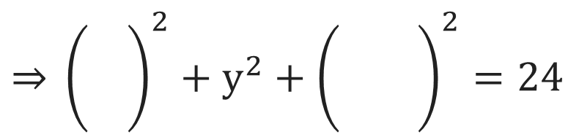
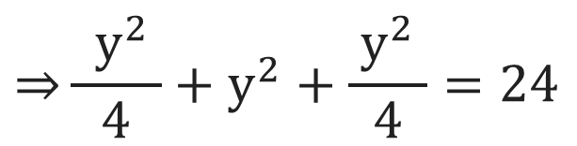
Example of Lagrange’s Multiplier Method
$$x=\frac{ y }{2}$$
Solution Continue:
$$x^{2}+y^{2}+z^{2}=24$$
$$− − →\left(4\right)$$
$$\frac{ y }{2}$$
$$x^{2}+y^{2}+z^{2}=24$$
$$− − →\left(5\right)$$
$$\frac{\left(x−1\right)}{x}=\frac{\left(y−2\right)}{y}=\frac{\left(z+1\right)}{z}$$
$$\frac{\left(y−2\right)}{y}=\frac{\left(z+1\right)}{z}$$
$$\text{⇒} {\left(\frac{\begin{aligned} \\ \end{aligned}}{ }\right)}^{2}+y^{2}+{\left(−\frac{\begin{aligned} \\ \end{aligned}}{ }\right)}^{2}=24$$
$$\text{⇒} z\left(y−2\right)=y\left(z+1\right)$$
$$\text{⇒}\frac{ { y}^{2} }{4}+y^{2}+\frac{{ y}^{2} }{4}=24$$
$$\text{⇒} yz−2z=yz+y$$
$$\text{⇒} y^{2}+4y^{2}+y^{2}=96$$
$$⇒z=−\frac{ y }{2}$$
$$−\frac{ y }{2}$$
$$− − →\left(6\right)$$
$$\text{⇒} 6y^{2}=96$$
$$\text{⇒} y^{2}=16$$
$$\text{⇒} y=±4$$

Slide 37
Example of Lagrange’s Multiplier Method
Solution Continue:
$$y=±4$$
$$x=\frac{ y }{2}$$
$$− − →\left(5\right)$$
$$z=−\frac{ y }{2}$$
$$− − →\left(6\right)$$
$$x=\frac{ y }{2}$$
$$z=−\frac{ y }{2}$$
$$⇒x=\frac{\begin{aligned} \\ ±4\end{aligned}}{2}$$
$$⇒z=−\frac{\begin{aligned} \\ ±4\end{aligned}}{2}$$
$$⇒x=±2$$
$$⇒z=∓2$$
Hence, stationary points are
P$\left(x, y, z\right)=P\left(2, 4, −2\right) \& P\left(−2, −4, 2\right)\text{.}$

Slide 38
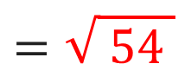
Example of Lagrange’s Multiplier Method
Solution Continue:
Stationary points are
P$\left(x, y, z\right)=P\left(2, 4, −2\right) \& P\left(−2, −4, 2\right)\text{.}$
$$PQ=$$
$$\sqrt{{ \left(x−1\right)}^{2}+{\left(y−2\right)}^{2}+{\left(z+1\right)}^{2} }$$
At, point $P\left(2, 4, −2\right)$
$$PQ=$$
$$\sqrt{ {\left(2−1\right)}^{2}+{\left(4−2\right)}^{2}+{\left(−2+1\right)}^{2} }$$
$$⇒PQ=\sqrt{ 6 }$$
$$=\sqrt{ 1+4+1 }$$
$$=\sqrt{ 6 }$$
Which is shortest distance
At, point $P\left(−2, −4, 2\right)$
$$⇒PQ=\sqrt{ 54 }$$
$$PQ=$$
$$\sqrt{{ \left(−2−1\right)}^{2}+{\left(−4−2\right)}^{2}+{\left(2+1\right)}^{2} }$$
Which is largest distance
$$=\sqrt{ 9+36+9 }$$
$$=\sqrt{ 54 }$$

Slide 39
Lagrange’s Multiplier Method
$$Y$$
The area of closed rectangular box is
$$A\left(x, y, z\right)=$$
$$2xy$$
$$+$$
$$2yz$$
$$+$$
$$2zx$$
The area of open rectangular box is
$$zx$$
$$xy$$
$$A\left(x, y, z\right)=$$
$$2xy$$
$$+$$
$$2yz$$
$$+$$
$$zx$$
$$yz$$
$$yz$$
The volume of open rectangular box is
$$X$$
$$V\left(x, y, z\right)=$$
$$xyz$$
$$xy$$
The volume of closed rectangular box is
$$zx$$
$$V\left(x, y, z\right)=$$
$$xyz$$
$$Z$$

Slide 40

Example of Lagrange’s Multiplier Method
Example 11:
A rectangular box open at the top is to have a given capacity of $64{ cm}^{3}\text{.}$
Find the dimension of the box requiring least material for it’s
construction$\text{.}$
Solution:
We have a open rectangular box with capacity $64{ cm}^{3}\text{.}$
$\text{⇒}$ volume
$$=xyz=64$$
The area of open rectangular box is
$$A=$$
$$2xy$$
$$+$$
$$2yz$$
$$+$$
$$zx$$
$$\text{⇒} f\left(x, y, z\right)=2xy+2yz+zx$$
$$\& ϕ\left(x, y, z\right)=xyz−64=0$$
$$2xy+2yz+zx$$
$$xyz−64$$
Construct the new function
$F\left(x, y, z\right)$as $F\left(x, y, z\right)=f\left(x, y, z\right)+λ$ $ϕ\left(x, y, z\right)\text{.}$
$$⇒F\left(x, y, z\right)=\left( \right)+λ\left( \right)$$

Slide 41
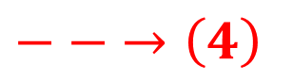
Example of Lagrange’s Multiplier Method
Solution Continue:
$$F\left(x, y, z\right)=\left(2xy+2yz+zx\right)+λ\left(xyz−64\right)$$
$$\frac{∂F}{ ∂x }=0, \frac{∂F}{ ∂y }=0, \frac{∂F}{ ∂z }=0 \& ϕ\left(x, y, z\right)=0$$
Solve the four equations
to find the
stationary points.
$$\frac{∂F}{ ∂x }=$$
$$\frac{∂F}{ ∂z }=$$
$$2y+z+λ\left(yz\right)=0$$
$$2y+x+λ\left(xy\right)=0$$
$$⇒λ=−\frac{ \left(2y+z\right) }{yz}$$
$$⇒λ=−\frac{ \left(2y+x\right) }{xy}$$
$$− − →\left(1\right)$$
$$− − →\left(3\right)$$
$$\frac{∂F}{ ∂y }=$$
$$xyz−64=0$$
$$2x+2z+λ\left(xz\right)=0$$
$$⇒λ=−\frac{ \left(2x+2z\right) }{xz}$$
$$\text{⇒} xyz=64$$
$$− − →\left(4\right)$$
$$− − →\left(2\right)$$

Slide 42
Example of Lagrange’s Multiplier Method
Solution Continue:
From equations $\left(1\right), \left(2\right) \& \left(3\right)$ we get
$$⇒xy\left(2x+2z\right)=xz\left(2y+x\right)$$
$$−\frac{\left(2y+z\right)}{yz}=−\frac{\left(2x+2z\right)}{xz}=−\frac{\left(2y+x\right)}{xy}$$
$$⇒2x^{2}y+2xyz=2xyz+x^{2}z$$
$$⇒2x^{2}y=x^{2}z$$
$$⇒\frac{\left(2y+z\right)}{yz}=\frac{\left(2x+2z\right)}{xz}=\frac{\left(2y+x\right)}{xy}$$
$$⇒z=2y$$
$$2y$$
From equation $\left(4\right)$
$$xyz=64$$
$$⇒xz\left(2y+z\right)=yz\left(2x+2z\right)$$
$$⇒\left( \right)y\left( \right)=64$$
$$⇒2xyz+{xz}^{2}=2xyz+2{yz}^{2}$$
$$⇒y^{3}=16$$
$$⇒4y^{3}=64$$
$$⇒{xz}^{2}=2{yz}^{2}$$
$$⇒y=2\sqrt[3]{ 2 }$$
$$⇒x=2y$$
$$2y$$

Slide 43

Example of Lagrange’s Multiplier Method
Solution Continue:
$$y=2\sqrt[3]{ 2 }$$
$$x=2y$$
$$z=2y$$
$$⇒x=4\sqrt[3]{ 2 }$$
$$⇒z=4\sqrt[3]{ 2 }$$
$\text{⇒}$ Dimensions
$$=\left(x, y, z\right)=\left(4\sqrt[3]{ 2 },2\sqrt[3]{ 2 },4\sqrt[3]{ 2 }\right).$$
Note: The possible answers are depends on formula of surface area.
If$A=2xy+yz+2zx$
then $\left(x, y, z\right)=\left(2\sqrt[3]{ 2 },4\sqrt[3]{ 2 },4\sqrt[3]{ 2 }\right)\text{.}$
If$A=xy+2yz+2zx$
then$\left(x, y, z\right)=\left(4\sqrt[3]{ 2 },4\sqrt[3]{ 2 },2\sqrt[3]{ 2 }\right)\text{.}$

Slide 44
Method:9
Gradient

Slide 45
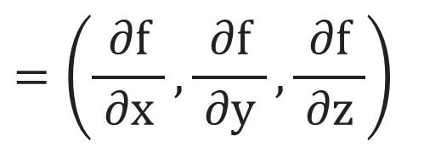
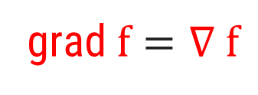
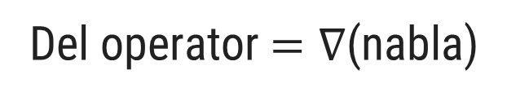
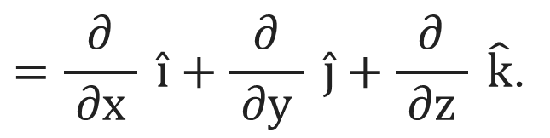
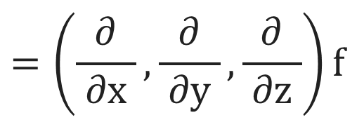
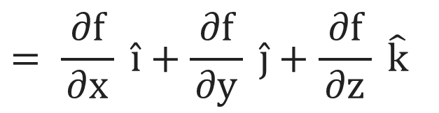
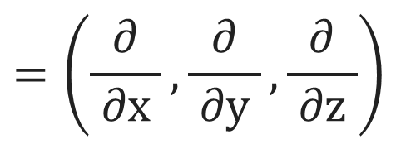
Gradient of a Scalar Function
A function whose codomain is scalars is called a scalar function.
Example: $f\left(x,y,z\right)=2x^{2}y+4z$is a scalar function.
$$=\left(\frac{∂}{ ∂x },\frac{∂}{ ∂y },\frac{∂}{ ∂z }\right)$$
$$=\frac{∂}{ ∂x } \hat{i}+\frac{∂}{ ∂y } \hat{j}+\frac{∂}{ ∂z } \hat{k}\text{.}$$
Del operator$=∇$(nabla)
The gradient of a scalar function $f(x, y,z)$ is denoted by $grad f/ ∇ f$ defined as
$$=\left(\frac{∂}{ ∂x },\frac{∂}{ ∂y },\frac{∂}{ ∂z }\right)f$$
$$=\left(\frac{ ∂f }{ ∂x }, \frac{ ∂f }{ ∂y }, \frac{ ∂f }{ ∂z }\right)$$
$$= \frac{ ∂f }{∂x} \hat{i}+\frac{ ∂f }{∂y} \hat{j}+\frac{ ∂f }{∂z} \hat{k}$$
grad$f=∇ f$
The gradient of scalar function is a vector.

Slide 46
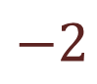

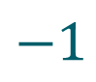
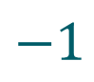

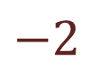
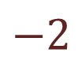
Example of Gradient of a Scalar Function
Example 1:
Find $∇ϕ$at$(1, −2, −1)$, if$ϕ=3x^{2}y−y^{3}z^{2}$.
Solution:
Here, $ϕ=3x^{2}y−y^{3}z^{2}$.
$$\left(\frac{ ∂ϕ }{ ∂x }, \frac{ ∂ϕ }{ ∂y }, \frac{ ∂ϕ }{ ∂z }\right)$$
$$⇒∇ϕ=$$
$$=\left( \right)$$
$$6xy,$$
$$3x^{2}−3y^{2}z^{2},$$
$$−2y^{3}z$$
$$⇒∇ϕ_{\left(1, −2, −1\right)}=\left(6\left( \right)\left( \right), 3{\left( \right)}^{2}−3{\left( \right)}^{2}{\left( \right)}^{2}, −2{\left( \right)}^{3}\left( \right)\right)$$
$$1$$
$$−2$$
$$1$$
$$−2$$
$$−1$$
$$−2$$
$$−1$$
$$=\left(−12, 3−12, −16\right)$$
$$⇒∇ϕ_{\left(1, −2, −1\right)}=\left(−12, −9, −16\right)$$

Slide 47
Example of Gradient of a Scalar Function
Example 5:
Evaluate
$∇e^{r^{2}},$
where$r^{2}=x^{2}+y^{2}+z^{2}\text{.}$
Solution:
Let, $f=e^{r^{2}}=e^{x^{2}+y^{2}+z^{2}}$.
$$\left(\frac{ ∂f }{ ∂x }, \frac{ ∂f }{ ∂y }, \frac{ ∂f }{ ∂z }\right)$$
$$⇒∇f=$$
$$=\left(e^{x^{2}+y^{2}+z^{2}}∙\left(2x\right), \right)$$
$$e^{x^{2}+y^{2}+z^{2}}∙\left(2y\right),$$
$$e^{x^{2}+y^{2}+z^{2}}∙\left(2z\right)$$
$$={2e}^{x^{2}+y^{2}+z^{2}}\left(x, y, z\right)$$
$$⇒∇f={2e}^{r^{2}}\left(x, y, z\right)$$

Slide 48
Method:10
Directional Derivative

Slide 49
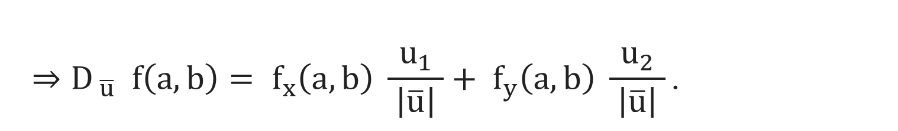
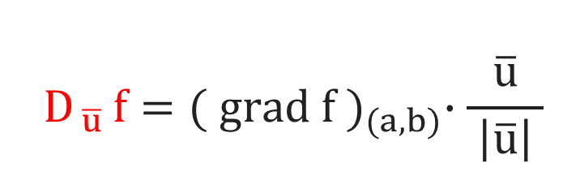
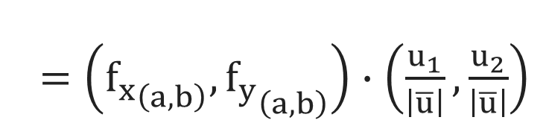
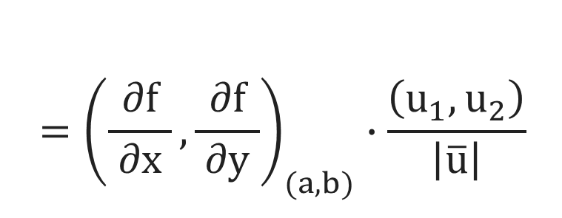
Directional Derivative
c
The directional derivative of$f(x, y)$at$(a, b)$in the direction $\overline{u}=(u_{1}, u_{2})$is
$$D_{ \overline{u} }f={( grad f )}_{(a, b)}∙\frac{\overline{u}}{ \left|\overline{u}\right| }$$
$$={\left(\frac{ ∂f }{ ∂x }, \frac{ ∂f }{ ∂y }\right)}_{(a, b)}∙\frac{\left(u_{1}, u_{2}\right)}{ \left|\overline{u}\right| }$$
$=\left({f_{x}}_{\left(a, b\right)},{f_{y}}_{\left(a, b\right)}\right)∙$ $\left(\frac{u_{1}}{\left|\overline{u}\right|},\frac{u_{2}}{\left|\overline{u}\right|}\right)$
$${⇒D}_{ \overline{u} }f\left(a, b\right)= f_{x}\left(a, b\right) \frac{u_{1}}{ \left|\overline{u}\right| }+ f_{y}\left(a, b\right) \frac{u_{2}}{ \left|\overline{u}\right| }\text{.}$$

Slide 50
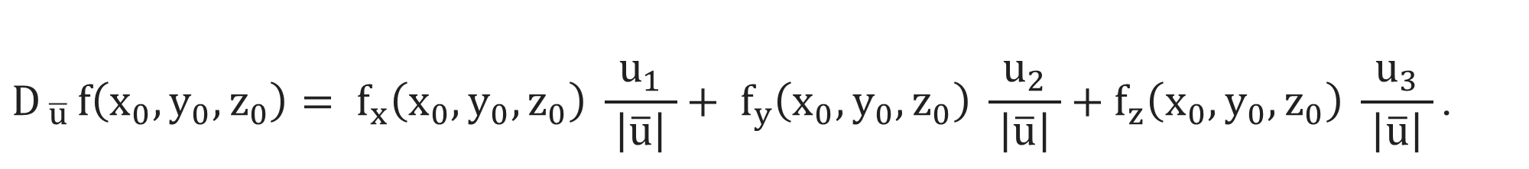
Directional Derivative
The directional derivative of $f(x, y, z)$at$\left(x_{0}, y_{0}, z_{0}\right)$ in the direction of
c
$\overline{u}=\left(u_{1}, u_{2}, u_{3}\right)$is
$$D_{ \overline{u} }f\left(x_{0}, y_{0}, z_{0}\right)= f_{x}\left(x_{0}, y_{0}, z_{0}\right) \frac{u_{1}}{ \left|\overline{u}\right| }+ f_{y}\left(x_{0}, y_{0}, z_{0}\right) \frac{u_{2}}{ \left|\overline{u}\right| }+f_{z}\left(x_{0}, y_{0}, z_{0}\right) \frac{u_{3}}{ \left|\overline{u}\right| }\text{.}$$
The directional derivative of$f\left(x, y\right)$in direction of unit vector$\overline{u}=\left(u_{1}, u_{2}\right)$which
c
makes an angle$α$with positive x-axis and at point$\left(x_{0}, y_{0}\right)$is
$$D_{ α }f\left(x_{0}, y_{0}\right)=\cos{α} f_{x}\left(x_{0}, y_{0}\right)+\sin{α} f_{y}\left(x_{0}, y_{0}\right)\text{.}$$

Slide 51


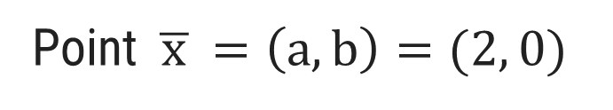
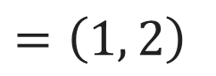
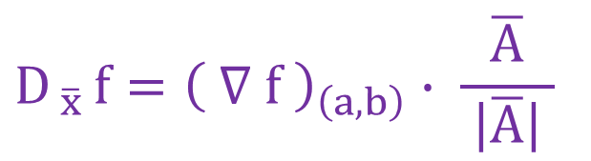
Example of Directional Derivative
Example 1:
Find directional derivative of $f\left(x, y\right)={xe}^{y}+cos xy$ at the point $(2, 0)$
in the direction $\overline{A}=3\hat{i}−4\hat{J}$.
Solution:
Here, $f\left(x, y\right)=xe^{y}+\cos{xy}$,
$$\&$$
Point $\overline{ x }=\left(a, b\right)=(2, 0)$
Direction $\overline{A}=\left(3, −4\right)\text{.}$
$$D_{ \overline{x} }f={\left( ∇ f \right)}_{\left(a, b\right)}∙ \frac{\overline{A}}{ \left|\overline{A}\right| }$$
$$− − →\left(1\right)$$
c
$$\left(\frac{ ∂f }{ ∂x }, \frac{ ∂f }{ ∂y }\right)$$
$$=\left( \right)$$
Now, $∇f=$
$$e^{y}−y sin xy ,$$
$$xe^{y}−x sin xy$$
$$⇒∇f_{\left(2, 0\right)}=\left(e^{0}−\left(0\right)\sin\left(2∙0\right), \left(2\right)e^{\left(0\right)}−\left(2\right)\sin\left(2∙0\right)\right)$$
$$⇒∇f_{\left(2, 0\right)}$$
$$=\left(1, 2\right)$$

Slide 52
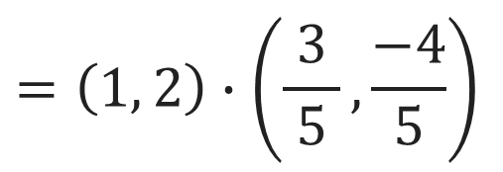
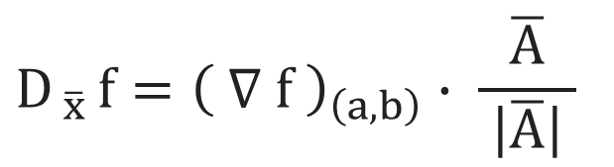
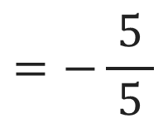
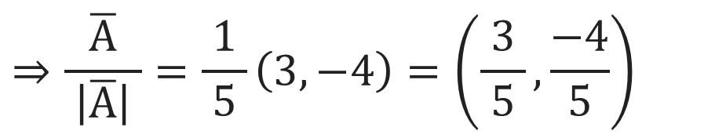
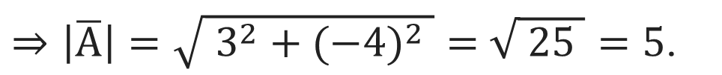
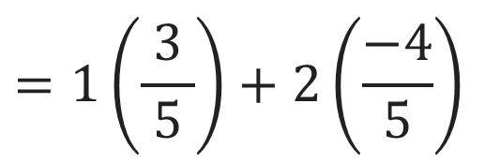
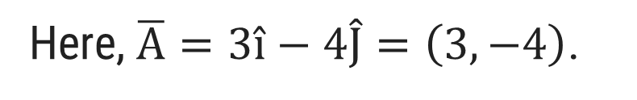

Example of Directional Derivative
Example 1:
Find directional derivative of $f\left(x, y\right)={xe}^{y}+cos xy$ at the point $(2, 0)$
in the direction $\overline{A}=3\hat{i}−4\hat{J}$.
Solution Continue:
Here, $\overline{A}=3\hat{i}−4\hat{J}=\left(3, −4\right)$.
$⇒\left|\overline{A}\right|=\sqrt{ 3^{2}+{(−4)}^{2} }=$ $\sqrt{ 25 }=5\text{.}$
$$⇒\frac{\overline{A}}{ \left|\overline{A}\right| }=\frac{1}{ 5 }\left(3, −4\right)=\left(\frac{3}{ 5 },\frac{−4}{ 5 }\right)$$
$$D_{ \overline{x} }f={\left( ∇ f \right)}_{\left(a, b\right)}∙ \frac{\overline{A}}{ \left|\overline{A}\right| }$$
$$=\left(1, 2\right)∙\left(\frac{3}{ 5 },\frac{−4}{ 5 }\right)$$
$$=1\left(\frac{3}{ 5 }\right)+2\left(\frac{−4}{ 5 }\right)$$
$$=−\frac{5}{ 5 }$$
$$⇒D_{ \overline{A} }f=−1$$

Slide 53
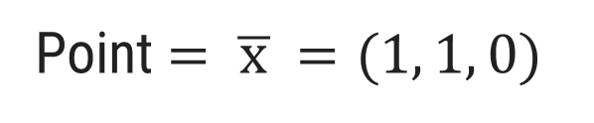
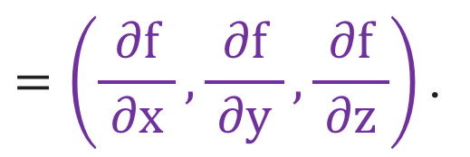

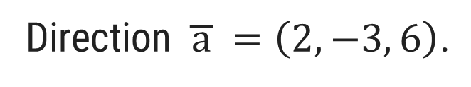
Example of Directional Derivative
Example 3:
Define gradient of a function. Use it to find directional derivative of
$f\left(x, y, z\right)=x^{3}−xy^{2}−z$at$P(1, 1, 0)$ in the direction $\overline{a}=2\hat{i}−3\hat{J}+6\hat{k}$.
Solution:
The gradient of a function $f(x, y,z)$ is denoted by $grad f/ ∇ f$ defined as
$$=\left(\frac{ ∂f }{ ∂x }, \frac{ ∂f }{ ∂y }, \frac{ ∂f }{ ∂z }\right)\text{.}$$
grad$f=∇ f$
Here, $f=x^{3}−{xy}^{2}−z,$
Point $=\overline{ x }=(1, 1, 0)$
$$\&$$
Direction $\overline{ a }=\left(2, −3, 6\right)\text{.}$
$$\left(\frac{ ∂f }{ ∂x }, \frac{ ∂f }{ ∂y }, \frac{ ∂f }{ ∂z }\right)$$
$$⇒∇f=$$
$$=\left( \right)$$
$$3x^{2}−y^{2},$$
$$−2xy,$$
$$−1$$
$$⇒∇f_{\left(1, 1, 0\right)}=\left(3{\left(1\right)}^{2}−{\left(1\right)}^{2}, −2\left(1\right)\left(1\right), −1\right)$$
$$⇒∇f_{\left(1, 1, 0\right)} =\left(2, −2, −1\right)$$

Slide 54
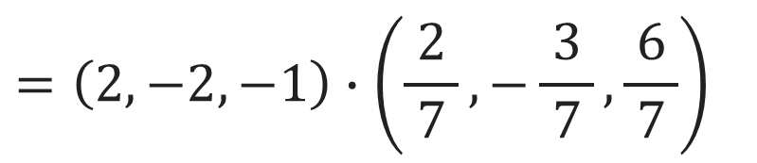
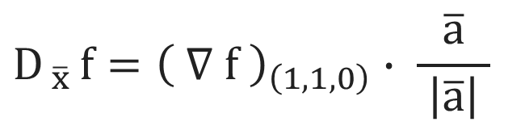
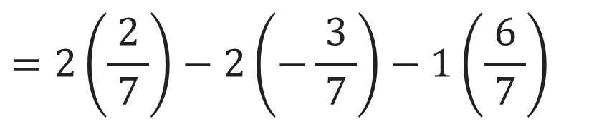
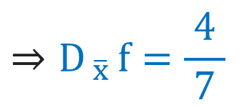
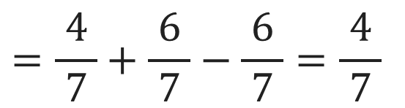
Example of Directional Derivative
Example 3:
Define gradient of a function. Use it to find directional derivative of
$f\left(x, y, z\right)=x^{3}−xy^{2}−z$at$P(1, 1, 0)$ in the direction $\overline{a}=2\hat{i}−3\hat{J}+6\hat{k}$.
Solution Continue:
Here, $\overline{a}=2\hat{i}−3\hat{J}+6\hat{k}=\left(2, −3, 6\right)$.
$$⇒\left|\overline{a}\right|=\sqrt{ 2^{2}+{\left(−3\right)}^{2}+6^{2} }$$
$=$ $\sqrt{ 4+9+36 }=\sqrt{ 49 }=7$
$$⇒\frac{\overline{a}}{ \left|\overline{a}\right| }=\frac{1}{ 7 }\left(2, −3, 6\right)=\left(\frac{2}{ 7 },−\frac{3}{ 7 },\frac{6}{ 7 }\right)$$
$$D_{ \overline{x} }f={\left( ∇ f \right)}_{\left(1, 1,0\right)}∙ \frac{\overline{a}}{ \left|\overline{a}\right| }$$
$$=\left(2, −2, −1\right)∙\left(\frac{2}{ 7 },−\frac{3}{ 7 },\frac{6}{ 7 }\right)$$
$$⇒D_{ \overline{x} }f=\frac{4}{ 7 }$$
$$=2\left(\frac{2}{ 7 }\right)−2\left(−\frac{3}{ 7 }\right)−1\left(\frac{6}{ 7 }\right)$$
$$=\frac{4}{ 7 }+\frac{6}{ 7 }−\frac{ 6 }{7}=\frac{ 4 }{7}$$

Slide 55




Example of Directional Derivative
Example 10:
Find the directional derivative of $x^{2}y^{2}z^{2}$ at $(1, 1, −1)$ along a direction
equally inclined with co-ordinate axis.
Here, $f=x^{2}y^{2}z^{2},$
Point $\overline{ x }=(1, 1, −1)$
Solution:
$$\&$$
Direction $\overline{ a }=\left(1, 1, 1\right)\text{.}$
$$\left(\frac{ ∂f }{ ∂x }, \frac{ ∂f }{ ∂y }, \frac{ ∂f }{ ∂z }\right)$$
$$=\left( \right)$$
$$⇒∇f=$$
$$2{xy}^{2}z^{2},$$
$$2{yx}^{2}z^{2},$$
$$2{zx}^{2}y^{2}$$
$$⇒∇f_{\left(1, 1, −1\right)}=$$
$$\left(2\left(1\right){\left(1\right)}^{2}{\left(−1\right)}^{2},2\left(1\right){\left(1\right)}^{2}{\left(−1\right)}^{2},2\left(−1\right){\left(1\right)}^{2}{\left(1\right)}^{2}\right)$$
$$⇒∇f_{\left(1, 1, −1\right)}=\left(2, 2, −2\right)\text{.}$$
Here, $\overline{a}=\left(1, 1, 1\right)$
$$⇒\left|\overline{a}\right|=\sqrt{ 1^{2}+1^{2}+1^{2} }$$
$=$ $\sqrt{ 3 }\text{.}$
c
$$⇒\frac{\overline{a}}{ \left|\overline{a}\right| }=$$
$$\frac{1}{\sqrt{ 3 }}\left(1, 1, 1\right)$$
$$=\left(\frac{1}{\sqrt{ 3 }}, \frac{1}{\sqrt{ 3 }},\frac{1}{\sqrt{ 3 }}\right)$$

Slide 56


Example of Directional Derivative
Example 10:
Find the directional derivative of $x^{2}y^{2}z^{2}$ at $(1, 1, −1)$ along a direction
equally inclined with co-ordinate axis.
Solution Continue:
$$D_{ \overline{x} }f={\left( ∇ f \right)}_{\left(1, 1,−1\right)}∙ \frac{\overline{a}}{ \left|\overline{a}\right| }$$
$$=\left(2, 2, −2\right)∙\left(\frac{1}{\sqrt{ 3 }}, \frac{1}{\sqrt{ 3 }},\frac{1}{\sqrt{ 3 }}\right)$$
$$=2\left(\frac{1}{\sqrt{ 3 }}\right)+2\left(\frac{1}{\sqrt{ 3 }}\right)−2\left(\frac{1}{\sqrt{ 3 }}\right)$$
$$=\frac{2}{\sqrt{ 3 }}$$
$$⇒D_{ \overline{A} }f=\frac{2}{\sqrt{ 3 }}$$

Slide 57


Example of Directional Derivative
Example 12:
Find the directional derivative $D_{u}f\left(x, y\right)$ if $f\left(x, y\right)=x^{3}−3xy+4y^{2}$
and u is the unit vector given by angle
$θ=\frac{π}{ 6 }\text{.}$What is $D_{u}f\left(1, 2\right)?$
Solution:
The directional derivative of$f\left(x, y\right)$in direction of unit vector$u=\left(u_{1}, u_{2}\right)$which
c
makes an angle $θ$ with positive x-axis and at point$\left(1, 2\right)$is
${D }_{u }f\left(1, 2\right)=\cos{θ} f_{x}\left(1, 2\right)+\sin{θ} f_{y}\left(1, 2\right)$.
Here, $f\left(x, y\right)=x^{3}−3xy+4y^{2}$
$$f_{y}=$$
$$−3x+8y$$
c
$$f_{x}=$$
$$3x^{2}−3y$$
$$⇒ f_{y}\left(1, 2\right)=$$
$$−3\left(1\right)+8\left(2\right)$$
$$=13$$
$$⇒ f_{x}\left(1, 2\right)=$$
$$3{\left(1\right)}^{2}−3\left(2\right)$$
$$=−3$$

Slide 58



Example of Directional Derivative
Example 12:
Find the directional derivative $D_{u}f\left(x, y\right)$ if $f\left(x, y\right)=x^{3}−3xy+4y^{2}$
and u is the unit vector given by angle
$θ=\frac{π}{ 6 }.$What is $D_{u}f\left(1, 2\right)?$
Solution Continue:
$${D }_{u} f\left(1, 2\right)=\cos{\frac{π}{ 6 }} f_{x}\left(1, 2\right)+\sin{\frac{π}{ 6 }} f_{y}\left(1, 2\right)$$
$$\frac{ \sqrt{ 3 }}{2}$$
$$=\left(\frac{\begin{aligned} \\ \end{aligned}}{ }\right)\left( \right)+\left(\frac{\begin{aligned} \\ \end{aligned}}{ }\right)\left( \right)$$
$$\frac{ 1 }{2}$$
$$−3$$
$$13$$
$$=\frac{ 13−3\sqrt{ 3 } }{2}$$
$${⇒D }_{u}f\left(1, 2\right)$$

Slide 59
Mathematics-I (M-I)
GTU # 3110014
THANK YOU
Prof. Darshan R. Pipaliya
Humanities & Science Department
darshan.pipaliya@darshan.ac.in
918160597689

